Slide 1
Mobile Game
In-App Purchase
Behavior Analysis
Final Data Analytics Project Presentation
Daniel Arias • Weican Ye • Arjun Mod • Nikhilesh Iyer
Gaming Analytics
Purchase Behavior
Power BI
Notes:
Open by saying the final presentation now uses the same dark gaming analytics visual style as the uploaded template, but the content is updated to include EDA and Power BI insights.

Slide 2
Presentation Roadmap
From raw data to EDA, Power BI visuals, and business conclusions
End-to-end
analytics
story
1
Project context
Question, objective, business value
2
Data foundation
Players + purchases, quality checks, KPIs
3
EDA findings
Demographics, segments, spending, engagement
Source: EDA report + Power BI dashboard visuals
4
Power BI visuals
Executive, segmentation, behavior dashboards
5
Insights & conclusion
Recommendations and final business message
Mobile Game In-App Purchase Behavior Analysis
2
Notes:
Preview the structure and emphasize that the final version focuses on insights and conclusions based on the EDA report and PBI screenshots.

Slide 3
Project Objective
Understand purchase behavior and turn raw gaming data into business-ready insight
Core question
What factors influence mobile gamers
to make in-game purchases?
Player profile
Engagement
Monetization
Age, gender, geography, device, genre
Session behavior, activity, game genre
Purchase amount, segment, payment method
Data → Patterns → Business
Decisions
Mobile Game In-App Purchase Behavior Analysis
3
Notes:
Explain that the project connects demographics, engagement, and payment data to business recommendations for monetization and retention.

Slide 4
Data Foundation & Quality
Two connected datasets support player and purchase analysis
Players dataset
Purchases dataset
Data quality
3,024 unique player records and 18 attributes including age, gender, country, device, genre, sessions, playtime, spending segment, and purchase metrics.
2,887 transaction records and 10 attributes including purchase amount, purchase date, payment method, purchase segment, and days since installation.
The transaction dataset is complete. Missing demographic and purchase-date fields are limited and manageable for EDA.
33.53
10.07
20.07
201.96
€97.97
€4,964
avg age
avg sessions
avg session length
avg playtime mins
avg IAP amount
max purchase
EDA reading
Conclusion
The large gap between median purchase (€11.46) and maximum purchase (€4,964.45) indicates a highly skewed spending distribution.
Average metrics are useful, but segmentation is necessary because a small group of users can strongly influence total revenue.
Mobile Game In-App Purchase Behavior Analysis
4
Notes:
Use this slide to connect data quality and descriptive statistics to the need for segmentation.

Slide 5
EDA Findings Summary
Key analytical patterns from the report before moving to Power BI
Demographics
Spending
Engagement
• Male players represent about 60% of all players.
• India has the largest player count; other markets are geographically diverse.
• Android is the leading platform at about 59%.
• Total revenue reached about €296.3K.
• Minnows are the largest group, but Whales are strategically important.
• Purchaser conversion is about 95.5%.
• Session length strongly correlates with playtime.
• Purchase amount has almost no correlation with playtime or session count.
• High spenders are not always the most active players.
Business insight
The final story should not simply describe charts. It should explain why the pattern matters: who spends, where revenue comes from, which platforms and payment methods matter, and how these findings should guide monetization strategy.
Presenter instruction: for every EDA or Power BI visual, state Insight → Evidence → Conclusion.
Mobile Game In-App Purchase Behavior Analysis
5
Notes:
This slide directly answers the group member request: tell presenters to provide insights and conclusions based on EDA and PBI visuals.

Slide 6
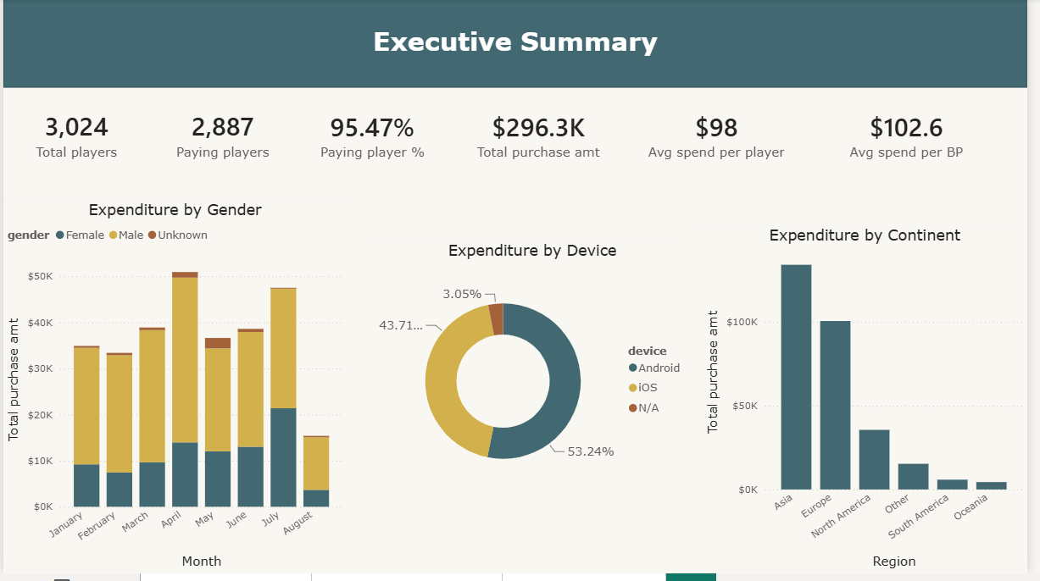
Power BI Executive Summary
KPI overview: players, conversion, purchase amount, device, gender, and geography
What to explain
High monetization baseline
The dashboard shows 3,024 players, 2,887 paying players, and a 95.47% paying-player rate.
Revenue concentration by region
Asia and Europe lead revenue, so localization and campaign focus should start there.
Device mix matters
Android contributes the larger device share, while iOS remains a strong secondary platform.
Mobile Game In-App Purchase Behavior Analysis
6
Notes:
Do not only describe the dashboard layout. For each visual, state the insight, identify evidence from the dashboard, and explain the business conclusion.

Slide 7
Executive Insights from PBI Visuals
Translate the dashboard into business meaning
95.47%
€296.3K
53.24%
~100K+
~130K+
conversion rate
total purchase value
Android purchase share
Europe revenue
Asia revenue
Insight 1: Strong conversion
Insight 2: Regional focus
Insight 3: Platform balance
A very high paying-player rate means the project should focus on maximizing value among existing payers, not only converting non-payers.
Asia and Europe should receive priority in localized campaigns, pricing tests, and regional event design.
Android should remain the main optimization priority, while iOS users still represent a valuable monetization base.
Business conclusion
The dashboard points to strong monetization performance. Growth should come from segment targeting, payment optimization, and market-specific offers rather than generic acquisition alone.
Mobile Game In-App Purchase Behavior Analysis
7
Notes:
Explain that the PBI executive page is the high-level business story. Highlight conversion, region, and platform as the main decision dimensions.

Slide 8
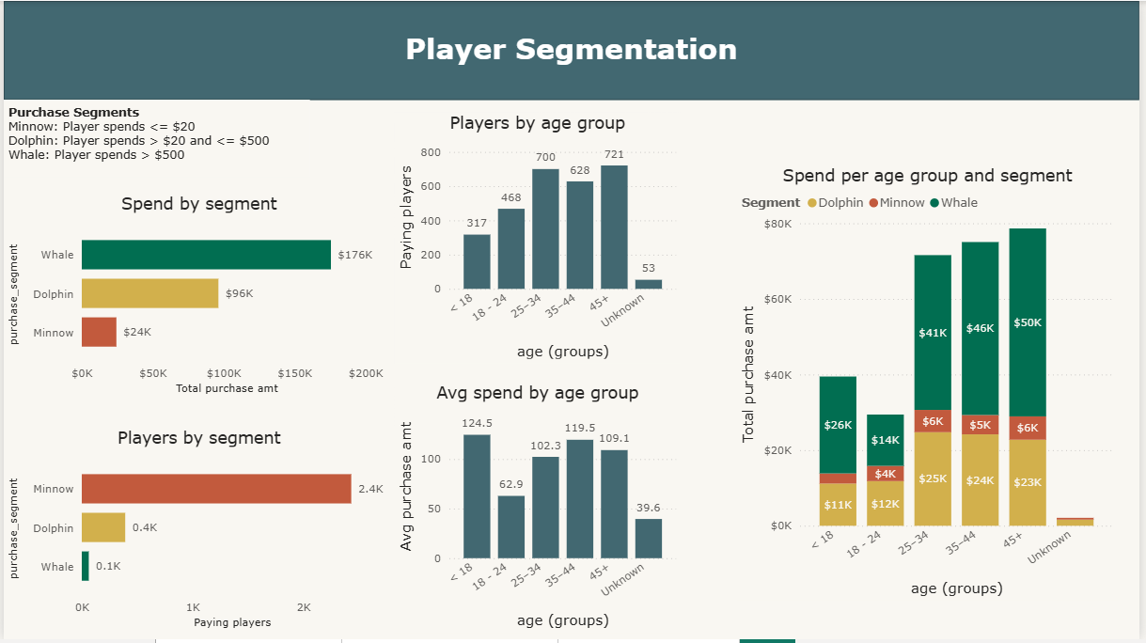
Power BI Player Segmentation
Revenue concentration by Minnow, Dolphin, and Whale segments
What to explain
Whales dominate revenue
Whales are the smallest player group but generate the highest segment revenue.
Minnows form the base
Minnows make up the largest population, but their individual revenue impact is low.
Age value pockets
25–34, 35–44, and 45+ show stronger revenue contribution than younger or unknown groups.
Mobile Game In-App Purchase Behavior Analysis
8
Notes:
Do not only describe the dashboard layout. For each visual, state the insight, identify evidence from the dashboard, and explain the business conclusion.

Slide 9
Segmentation Insight: Revenue Is Uneven
Player count and revenue contribution move in opposite directions
Minnow
Dolphin
Whale
≈2.4K players
≈€24K revenue
≈0.4K players
≈€96K revenue
≈0.1K players
≈€176K revenue
Segment revenue comparison
Insight
Minnow
The largest group is not the most profitable group; small high-value users create most monetization impact.
Dolphin
Whale
Conclusion: protect Whale retention, upgrade Dolphins through targeted offers, and raise Minnow contribution with low-friction bundles.
Mobile Game In-App Purchase Behavior Analysis
9
Notes:
This slide should be presented as a business conclusion. Segmentation changes the marketing strategy.

Slide 10
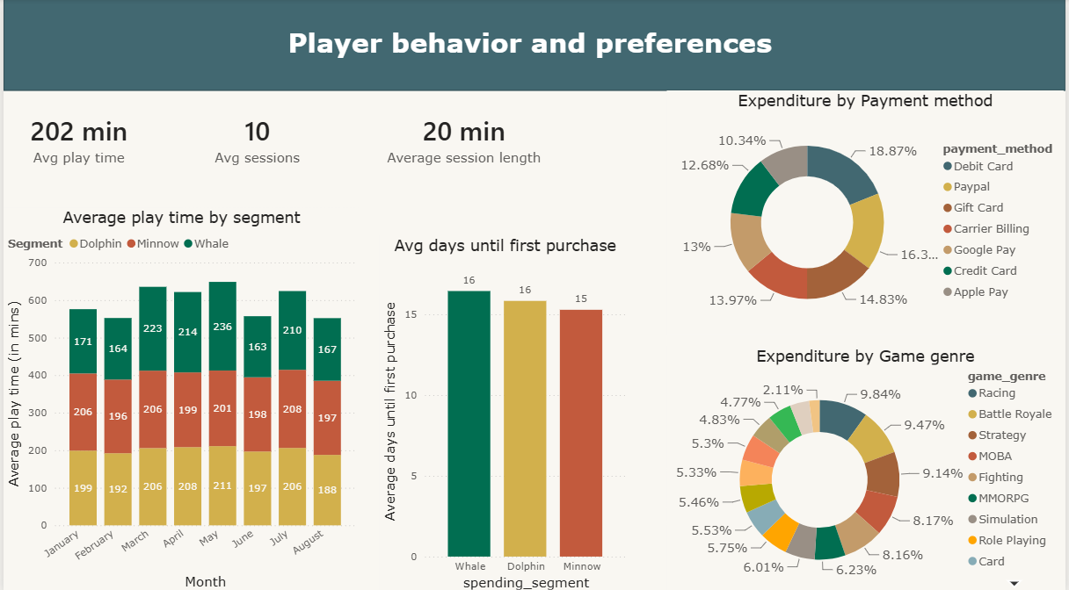
Power BI Player Behaviour & Preferences
Session behavior, first purchase timing, payment methods, and game genre spending
What to explain
Engagement is steady
Average playtime is similar across segments, so higher spending is not simply caused by longer playtime.
First purchase timing
Average days until first purchase is close across segments, around 15–16 days.
Diversified channels
Revenue is spread across multiple payment methods and game genres, reducing dependence on one route.
Mobile Game In-App Purchase Behavior Analysis
10
Notes:
Do not only describe the dashboard layout. For each visual, state the insight, identify evidence from the dashboard, and explain the business conclusion.

Slide 11
EDA Insight: Engagement Does Not Explain Spending Alone
Correlation results separate gameplay activity from monetization behavior
0.781
0.565
0.001
0.035
Main message
session length vs playtime
session count vs playtime
purchase vs playtime
purchase vs sessions
Playing more does not automatically mean spending more.
Interpretation
Business meaning
Engagement metrics explain activity patterns, but they barely explain purchase amount. High spenders may not be the players with the longest playtime or most sessions.
Monetization needs player motivation, personalized offer design, and value perception. Revenue strategy should not rely only on increasing playtime.
Conclusion: recommend segment-based monetization actions, not only engagement-growth actions.
Mobile Game In-App Purchase Behavior Analysis
11
Notes:
This is one of the most important EDA slides. Emphasize that spending behavior requires monetization-specific strategy.

Slide 12
Payment & Genre Insights
Power BI visuals show diversified monetization channels
Payment method
Game genre
First purchase
Debit Card leads revenue, but PayPal, Gift Card, Carrier Billing, Google Pay, Credit Card, and Apple Pay all matter.
No single game genre dominates purchase value; spending is spread across different preferences.
Segments reach first purchase at similar times, so early lifecycle offers can be broadly planned.
Business implications
• Keep multiple payment methods active to reduce purchase friction.
• Use genre-based promotions instead of assuming one genre contains all high-value users.
• Test offers around the first two weeks after install, when conversion behavior becomes visible.
Conclusion
Payment flexibility and genre personalization should be part of the monetization strategy. The dashboard supports a broad but targeted approach: many channels matter, but offers should still be adjusted by segment and preference.
Mobile Game In-App Purchase Behavior Analysis
12
Notes:
Tell the team to present payment and genre charts as decision tools: reduce payment friction and personalize by preference.

Slide 13
Business Recommendations
Actions connected directly to EDA and Power BI findings
1. Protect Whales
2. Upgrade Dolphins
3. Reduce payment friction
Create loyalty benefits, VIP bundles, and exclusive content for the highest-value segment.
Use personalized offers to move medium spenders toward higher lifetime value.
Maintain multiple payment methods because revenue is distributed across payment channels.
4. Optimize Android first
5. Localize top regions
6. Personalize by genre
Android is the largest platform group; prioritize performance, UX, and campaign testing there.
Asia and Europe should receive localized campaigns, pricing experiments, and events.
Use genre preferences to adjust bundles, events, and in-game content offers.
Recommendation logic: combine segment value, payment preference, platform priority, and regional concentration into one monetization plan.
Mobile Game In-App Purchase Behavior Analysis
13
Notes:
Use this slide to show that each recommendation links back to a specific EDA or PBI finding.

Slide 14
Final Conclusion
What the analysis says about mobile game in-app purchase behavior
Main conclusion
The game shows strong monetization performance, but revenue is concentrated in a small high-value segment.
EDA conclusion
PBI conclusion
Business conclusion
Spending is highly skewed and only weakly linked to general gameplay engagement.
Revenue varies by segment, region, platform, payment method, and age group.
Best next actions are retention of high-value users and personalization of monetization offers.
Q&A
Thank you
Mobile Game In-App Purchase Behavior Analysis
14
Notes:
Close with the overall business message: do not present only the charts; present the insight, evidence, and decision that follows from the evidence.

